Slide 1
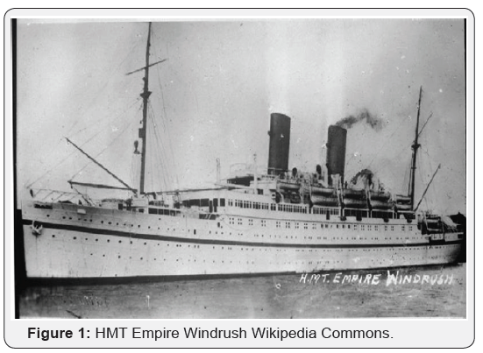
PE:
As well-rounded, active citizens, our children will engage in a wide range of physical activities.
This term, our sessions will be on football and dance and will be guided by the Premier Sports Group on Fridays. The Year 5s & 6s will also have the opportunity to have swimming lessons this term at Quayside Leisure Centre. We will have netball club on a Tuesday & football club on Fridays and Mondays. Please can the children who do football club bring a change of shoes into school.
Forest School:
We are extremely fortunate to be able to access provision for outdoor learning which can increase a child's confidence and self-esteem through exploration, problem solving, and being encouraged to learn how to assess and take appropriate risks depending on their environment. Please ensure children come to school with appropriate clothing and footwear for these sessions on Wednesdays.
Art & Design:
As artists, we will be learning about the work of Valerie Davide. Born in London the year before the outbreak of war. Val’s formative years were challenging to say the least. Sanctuary came during periods spent with her grandparents in North Cornwall where she later settled herself for many years. After a successful career as a Counsellor for people with addictions, Valerie turned her attentions to drawing. Over the course of her working life, she had often introduced art therapy into her sessions to a mutually fulfilling response. Upon retiring and settling down to beach life Valerie was able to fully indulge herself into her world of curious cows, terrible terriers and big nostrilled horses.
Science:
As scientists, in this unit of learning, the children will understand and identify that animals, including humans, obtain food in different ways and need the right type and amount of nutrition. We will find out about food groups and healthy balanced diets and compare diets of herbivores, carnivores and omnivores. We will also explore different types of teeth including milk and permanent teeth; incisors, canines and molars.
.
Maths:
As mathematicians Years 3&4 will be learning about Place Value & Addition & Subtraction. Years 5&6 will also be learning about Place Value and Addition, Subtraction, Multiplication & Division. We will continue to practise our times-tables every day.
Croft Class
Autumn - 2024
RHE: As well -rounded citizens, the children will be looking at what good manners are and how to respect ourselves and others’ boundaries. We will be looking at how to positively assert our own boundaries whilst respecting others’ feelings. We will also be looking at bullying, stereotypes and how to support someone through bereavement.
Music:
As musicians, we will be exploring identity through song & we are also fortunate enough to have Jane Bickle again. We will be focusing on playing the violin this term. We will also explore playing to a beat, looking at the length of time some musical notes require and reading music.
History and Geography:
As geographers, we will learn about the water cycle. We will look at how rivers shape the land, the different parts of rivers and how they are important.
As historians, we will learn about the Windrush generation, including who they are, their impact on Britain, where they are today and how the Windrush generation are celebrated.
English: In English this term we will be looking at the BFG by Roald Dahl and exploring the techniques employed to entertain the reader. We will be writing our own sentences in the style of Roald Dahl and hoping to entertain and amuse our audience in a similar style! We will continue to do Guided Reading on the text ‘Blitz Bus’. We will also have a strong focus on handwriting this term to ensure the children can clearly communicate their great ideas!
RE:
In R.E. we will be looking at the Creation Story in Genesis. We will explore the story and try and understand what the significance & impact of this scripture is on Christians.
We will also research what Hindus believe God is like
Christian Distinctiveness:
We demonstrate our Christian Values through daily acts of collective worship, singing worship and family group acts of worship.

